Slide 1


Introduction to Water Chemistry & Hardness
Course Code: ETMLCH104
Course Name: Engineering Chemistry
Program: B.Tech. (AI/ML)
Unit 2: Chemical Fuels
Dr. Mehak Ahuja
Assistant Professor, Department of Chemistry
School of Basic and Applied Sciences
K.R. Mangalam University
Sohna Road, Gurugram

Slide 2

Course Overview
UNIT WISE DETAILS ​ ​ ​
Unit Number: 1 ​ | Title: Water technology ​ | No. of hours: 6 ​
Content Summary: ​ Introduction, water analysis: Hardness-determination by EDTA method, Treatment of boiler feed water: Internal treatment (Phosphate, Colloidal and Calgon conditioning). External treatments: Ion exchange and lime-soda process, Zeolite processes. Boiler scales formation and ill effects, methods of prevention of scales. Numerical problems ​
Unit Number: 2 ​ | Title: Chemical Fuels ​ | No. of hours: 9 ​
Content Summary: ​ Fuels: Introduction, classification, calorific value (HCV & LCV), Determination of calorific value of fuel using Bomb calorimeter. ​ Solid fuel: Coal- its analysis by proximate and ultimate analysis, Numerical problems. ​ Liquid fuels: Refining of petroleum, Petroleum cracking, Knocking in IC engine, its ill effects and prevention of knocking. Anti-knocking agent: Leaded and unleaded petrol. ​ Gaseous fuels: LPG, CNG and their applications. ​
Unit Number: 3 ​ | Title: Battery Technology ​ | No. of hours: 10 ​
Content Summary: ​ Introduction - Galvanic cell, electrode potential, EMF of the cell and cell representation. Batteries and their importance, Classification of batteries- primary, secondary and reserve batteries with examples. Battery characteristics - voltage, capacity, energy density, power density, energy efficiency, cycle life and shelf life. ​ Construction, working and applications of: Ni-Cd, and Lithium-ion battery. Working principle of an electric vehicle. ​
Unit Number: 4 ​ | Title: Polymer ​ | No. of hours: 5 ​
Content Summary: ​ Basic concepts of polymer, Types of polymers, Thermoplastic & thermosetting plastics, Preparation and application of some industrially important polymers (Natural rubber, Buna S, Buna-N, Neoprene, Isoprene, Nylon-6, nylon-6,6 , Decron and Terylene). Conducting and biodegradable polymers. ​

Slide 3
COURSE OUTCOMES
CO1: Understand the methods for water hardness and the basics of boiler water treatment and analyze fuel calorific values and battery.
CO2: Explain the characteristics and working principles of different battery types and types of fuels.
CO3: Determine the differences between batteries and fuel cells and classify fuel cell types based on their components..
CO4: Identify between hard and soft water, solve the related numerical problems on water purification and emf and its significance in industry and daily life.

Slide 4

Solid fuel: Coal
analysis by proximate and ultimate analysis

Slide 5

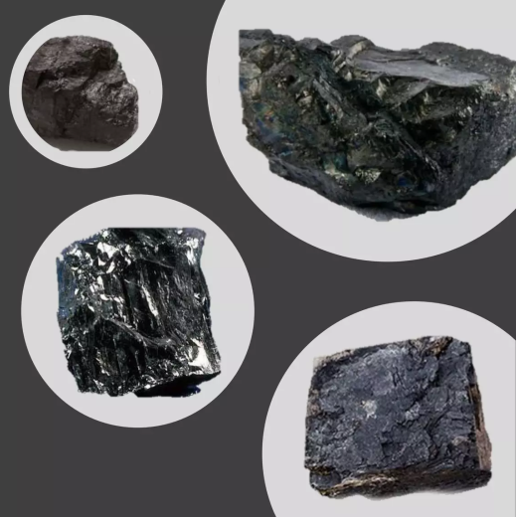

COAL – SOLID FUEL
Coal is an organic rock as opposed to most other rocks in the earth’s crust such as clays and sandstone, which are inorganic.
It contains mostly carbon (C)
It also has Hydrogen, Oxygen, Sulfur and Nitrogen
It also has some inorganic constituents minerals and water.

Slide 6
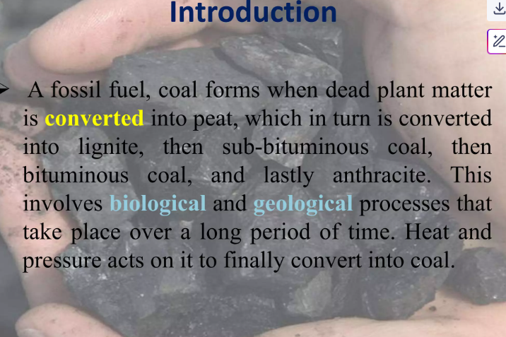

Slide 7
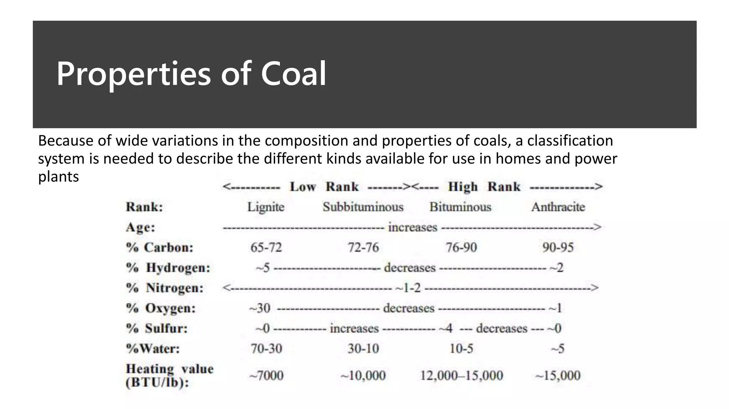

Slide 8
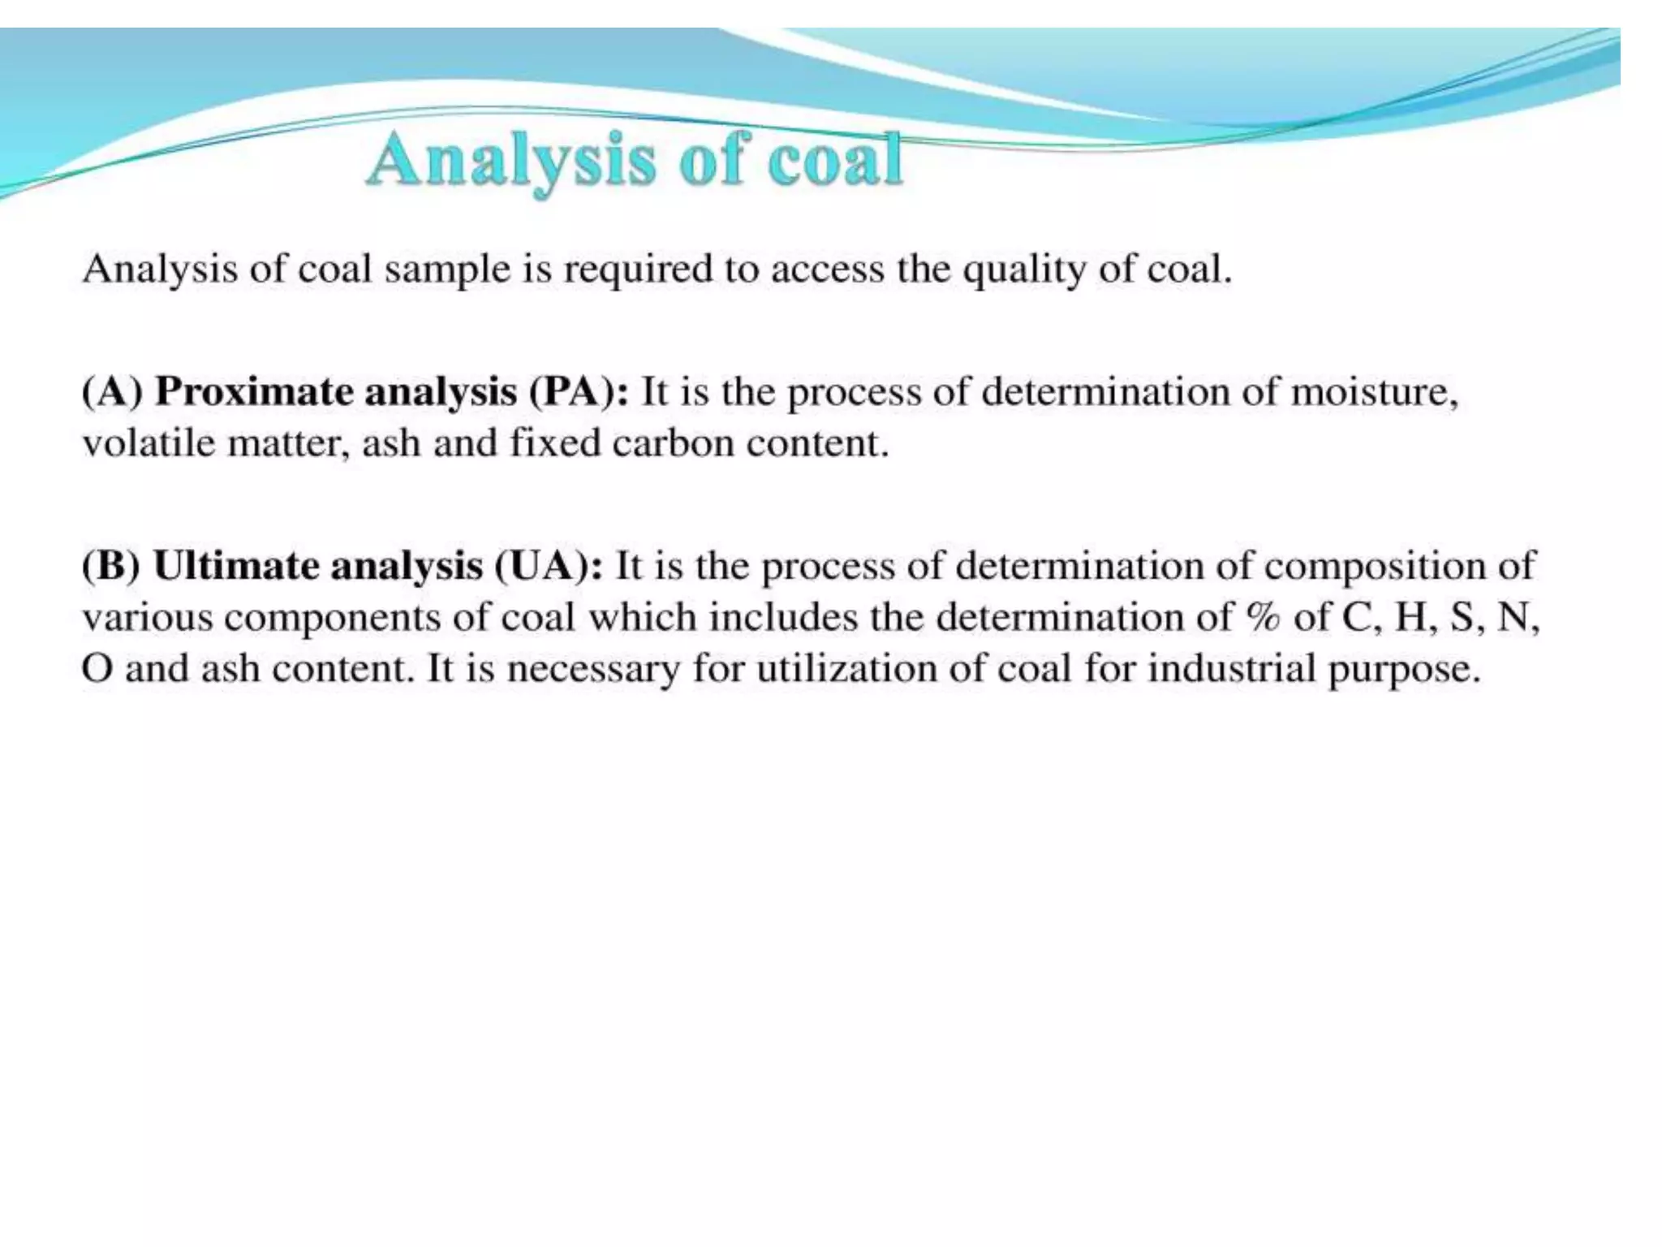
Analysis of Coal

Slide 9
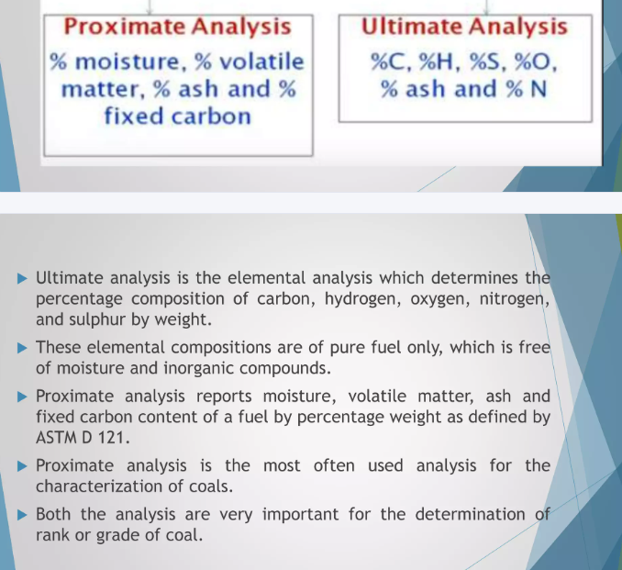
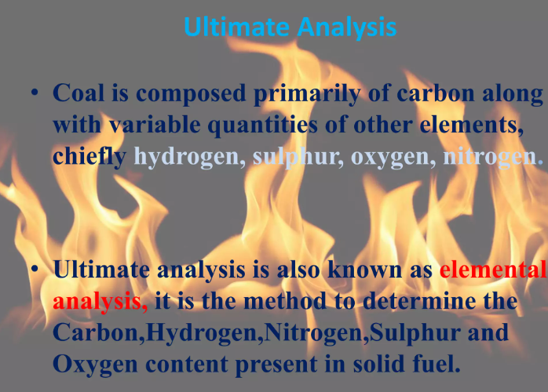

Slide 10
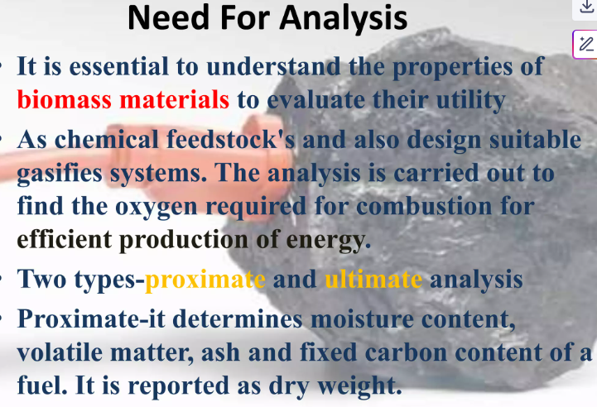

Slide 11
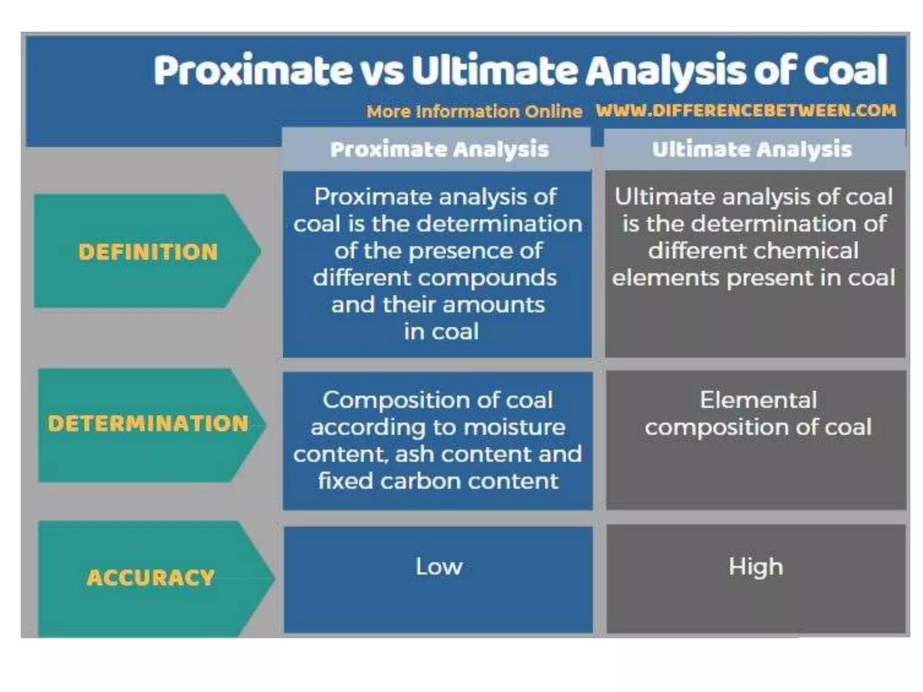

Slide 12
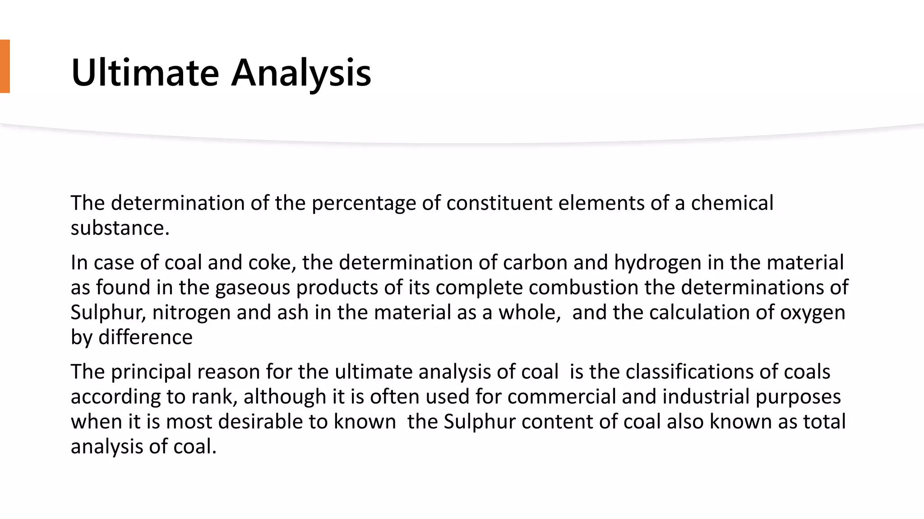
Notes:
New Courses replaced with New Programmes

Slide 13
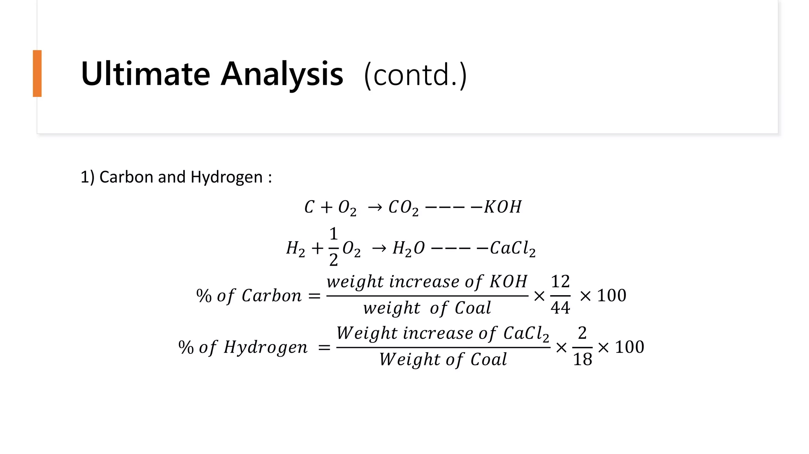
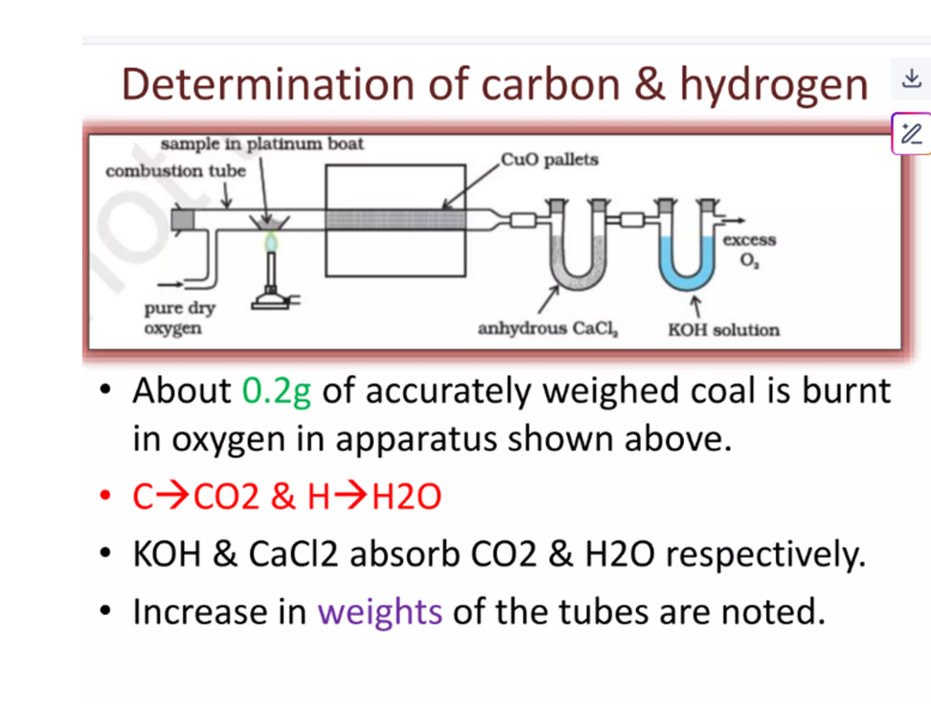
Notes:
New Courses replaced with New Programmes

Slide 14
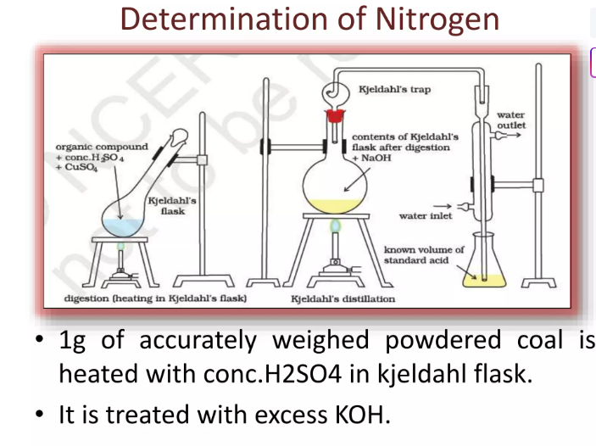

Slide 15
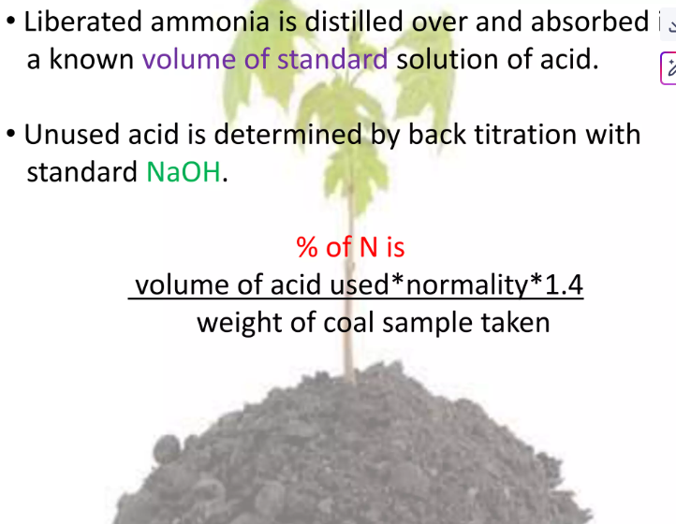

Slide 16
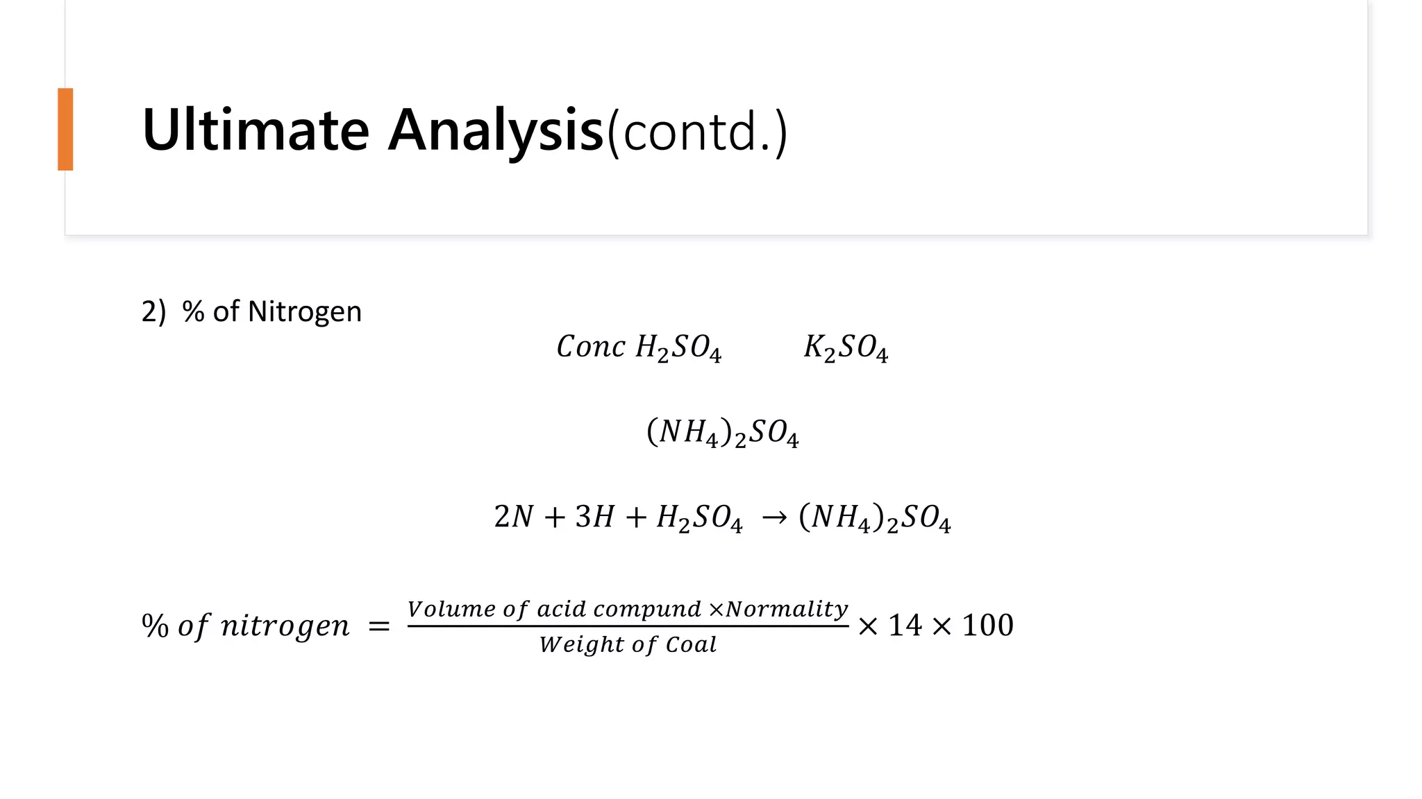
Notes:
New Courses replaced with New Programmes

Slide 17
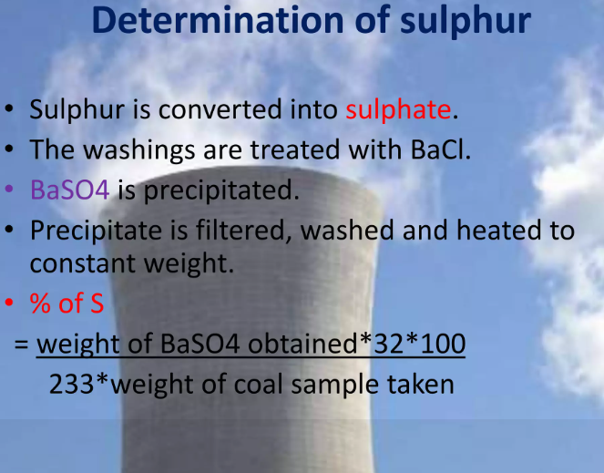

Slide 18
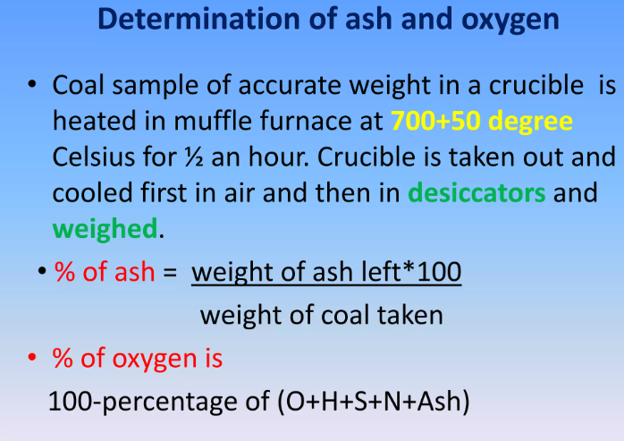

Slide 19
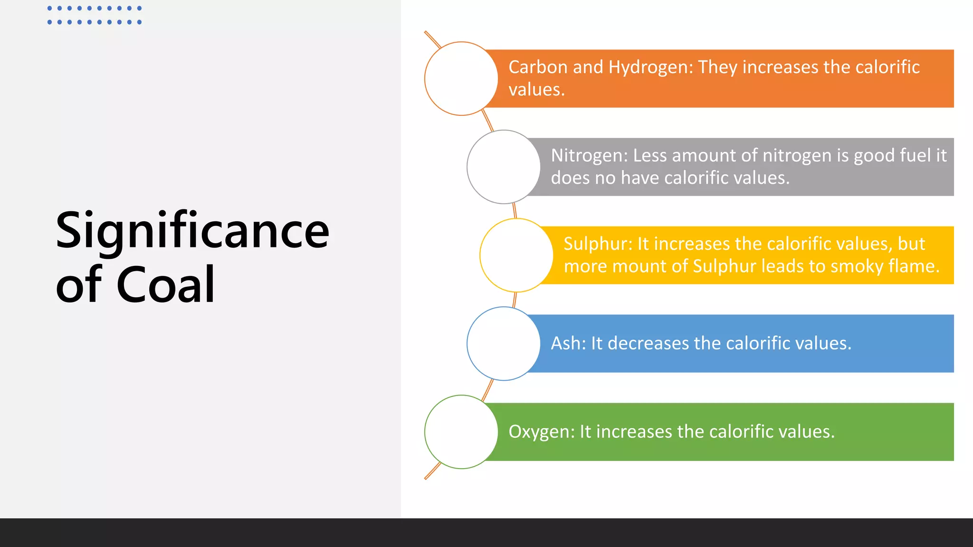
Notes:
New Courses replaced with New Programmes

Slide 20
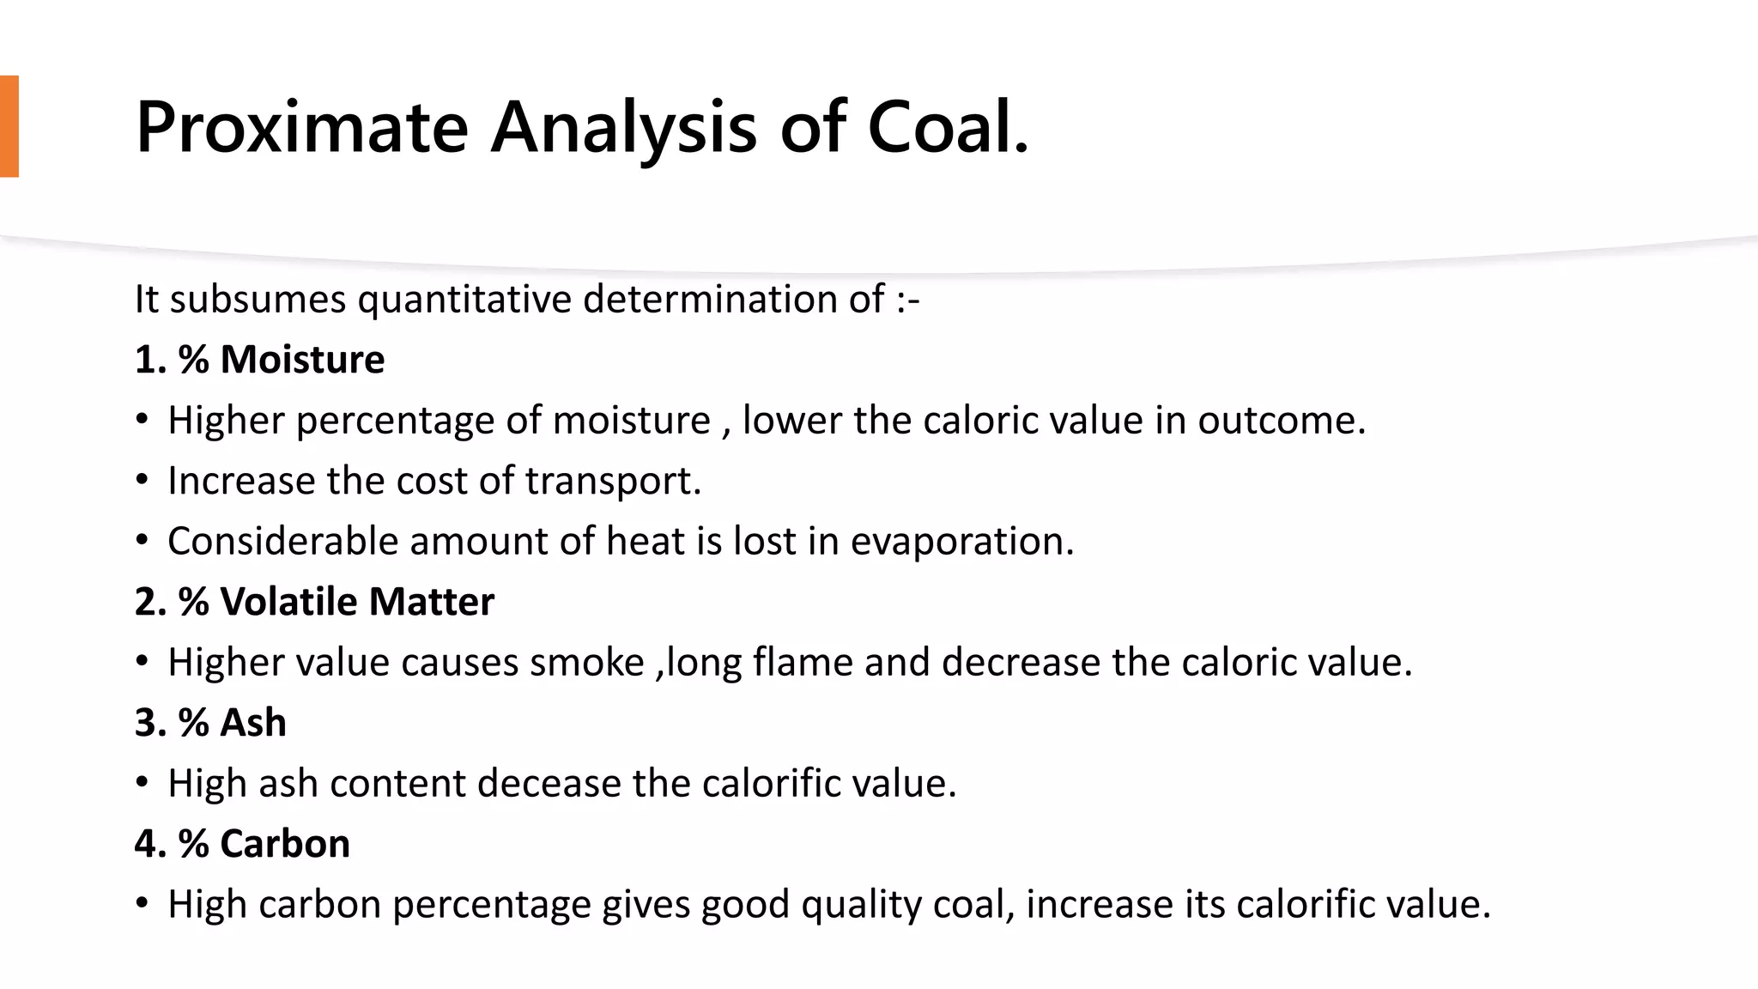
Notes:
New Courses replaced with New Programmes

Slide 21
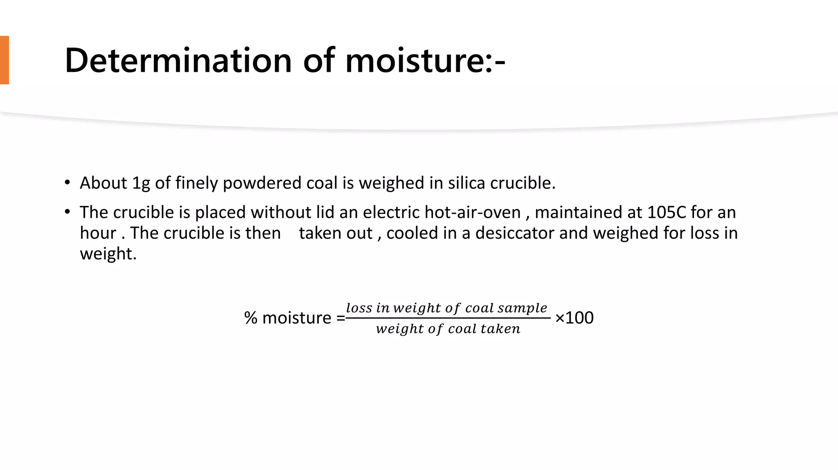
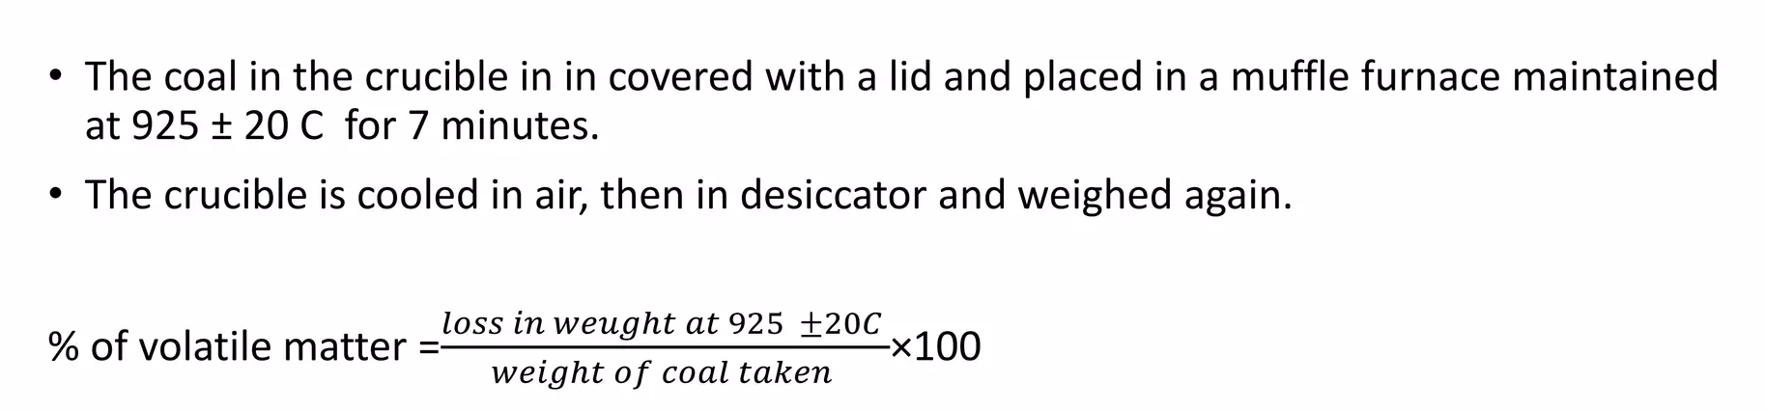
Determination of % Moisture:
Determination of % Volatile matter:
Notes:
New Courses replaced with New Programmes

Slide 22
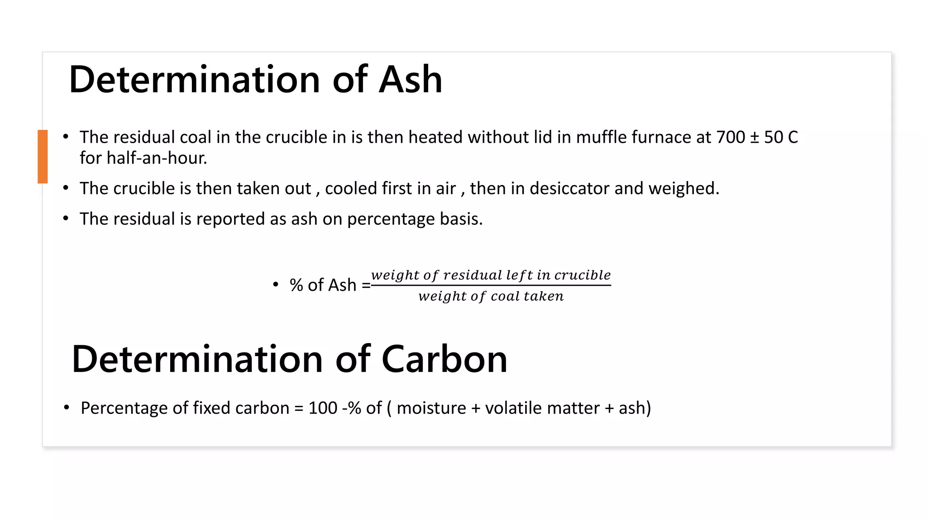
Notes:
New Courses replaced with New Programmes

Slide 23
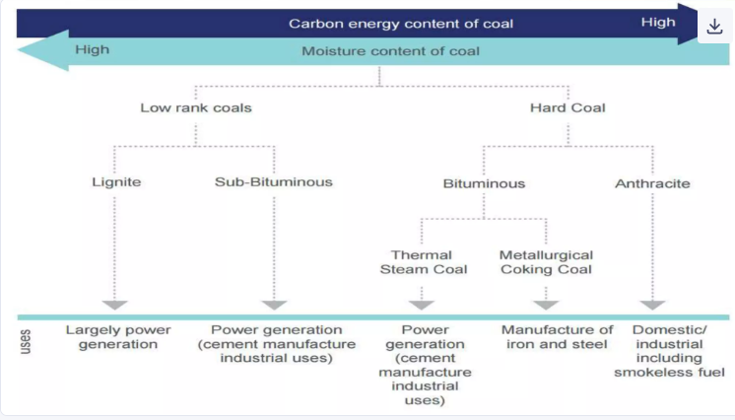

Slide 24
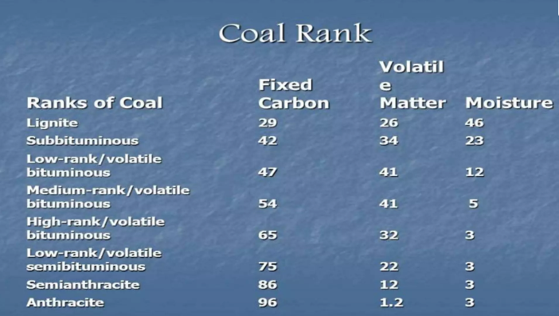

Slide 25
Take away of the session
Definition: Coal is a solid fossil fuel formed by the decomposition of plant material under heat and pressure over millions of years.
Types of Coal:
Peat (lowest grade)
Lignite (brown coal)
Bituminous (most widely used)
Anthracite (highest carbon content, burns cleanly)
Constituents: Mainly carbon, along with hydrogen, sulfur, nitrogen, ash, and moisture.
Uses: Power generation, steel industry (coke), domestic fuel, chemical industries.
Drawbacks: Causes pollution, ash disposal problems, and emits greenhouse gases

Slide 26
Questions
1. Which type of coal has the highest carbon content? A. Peat B. Lignite C. Bituminous D. Anthracite ✅ Answer: D
2. Which of the following is the lowest grade of coal? A. Anthracite B. Peat C. Bituminous D. Lignite ✅ Answer: B
3. What is the primary element present in coal? A. Sulfur B. Oxygen C. Nitrogen D. Carbon ✅ Answer: D
4. Which coal type is most commonly used for electricity generation? A. Anthracite B. Bituminous C. Peat D. Graphite ✅ Answer: B
5. One major environmental concern of coal usage is: A. High energy efficiency B. Lack of availability C. Air pollution and CO₂ emissions D. Fuel spillage ✅ Answer: C

Slide 27
Learning Outcomes
BTL-1: Recall definitions and types of fuels (CO2)
BTL-2: Explain characteristics of solid, liquid, and gaseous fuels;
define calorific value (CO1, CO2)
BTL-3: Apply knowledge to identify ideal fuels and solve questions
related to fuel properties (CO1, CO2)
CO1: Understand the methods for water hardness and the basics of boiler water treatment and analyze fuel calorific values and battery.
CO2: Explain the characteristics and working principles of different battery types and types of fuels.
Mapped Course Outcomes

Slide 28
References
Engineering Chemistry by Jain and Jain.

